Slide 1

Bluetooth Controlled RC Car
Prepared by : Medhat Ahmed Medhat
Registration Number:17100162

Slide 2
Introduction
This is an Arduino based, Bluetooth controlled RC car. It is controlled by a smart phone application.
Bluetooth controlled car is controlled by using Android mobile phone instead of any other method like
buttons, gesture etc. Here only needs to touch buttons or tilt motion or
voice control in android phone to control the car in forward,
backward, left and right directions. So here android phone is used as transmitting device and Bluetooth
module placed in car is used as receiver. Android phone will transmit command using its in-built Bluetooth
to car so that it can move in the required direction like moving forward, reverse, turning left, turning right
and stop.

Slide 3
Hardware Components
Arduino Uno
HC-05 Bluetooth Module
Motor Driver Module L298N
Micromors and Grippy Wheels
Jumper Wires

Slide 4
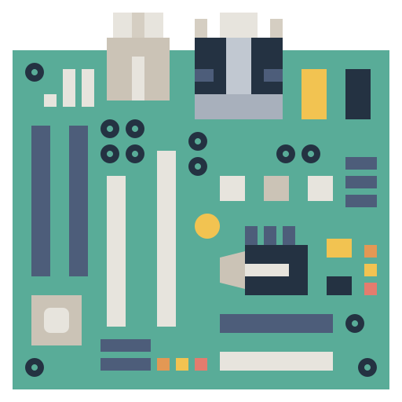
Arduino uno
The Arduino Uno is an open-source .The board is equipped with sets of digital and
Analog input/output (I/O) pins that may be interfaced to various expansion boards (shields) and other
Circuits. The board has 14 digital I/O pins programmable with the Arduino IDE. In my project I used pins 10,11,12,13

Slide 5

HC-05 Bluetooth Module
HC-05 is a Bluetooth module which is designed for wireless communication. It has range up to <100m which
It uses frequency-hopping spread spectrum (FHSS) radio technology to send data over air. It uses serial communication to communicate with devices. It communicates with microcontroller using serial port

Slide 6
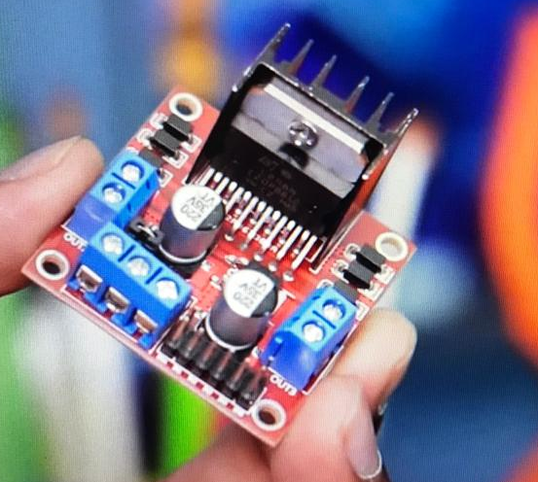
Motor Driver Module L298N
This L298N Based Motor Driver Module is a high power motor driver perfect for driving DC Motors. It uses the popular L298 motor driver IC and has the onboard 5V regulator which it can supply to an external circuit. It can control up to 4 DC motors, or 2 DC motors with directional and speed control This motor driver is perfect for robotics and mechatronics projects and perfect for controlling motors from microcontrollers, switches, relays, etc.

Slide 7
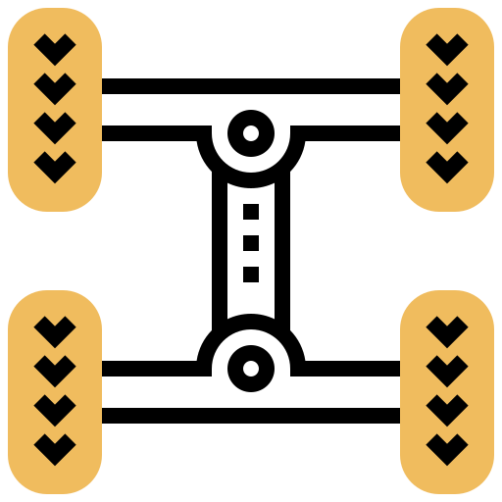
Micromors and Grippy Wheels
Four wheeled
have four drive motors and use skid steering.

Slide 8
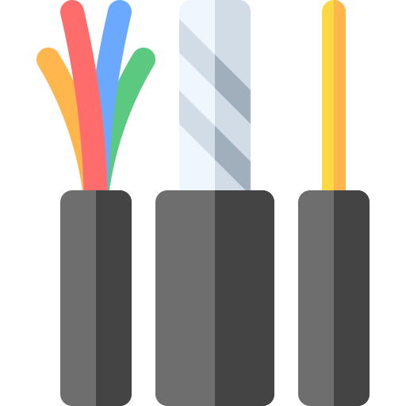
Jumper Wires
A jump wire is an electrical wire or group of them in a cable with a connector or pin at each end. Wires are used to connect components to each other on the breadboard or other prototype, internally or with other equipment or components, without soldering. Wire connectors could be male or female.

Slide 9
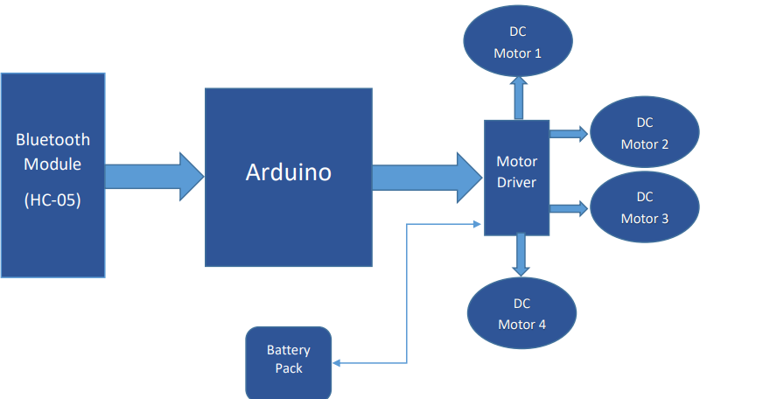
Block Diagram
Here the whole system is divided into four principle blocks Bluetooth block, microcontroller block, and motor driver block and the battery pack block
The Bluetooth block comprises of the Bluetooth module present in the mobile phone used along with the Bluetooth module used in the car. The mobile phone consists of an application that provides an interface to send ASCII characters via Bluetooth which is then received by the Bluetooth module on the car
The microcontroller then receives the data from the Bluetooth module and then manipulates the data received into series of digital outputs which run the motor driver section

Slide 10
Software Description
Arduino software is used to put the instruction of whole functions of this system to the microcontroller. Here we use programming language ‘C‘ for coding.
Android Studio is used to develop the mobile application that controls the car using programming language ‘JAVA’
By using these two softwares we put the data and instruction for forward,backward, left, right operation of this system.

Slide 11
How the operation works ?
The Arduino program is stored in the EEPROM of the microcontroller, which is present in the NodeMCU ESP8266.
In android application when we press a button, a corresponding signal is sent through the Bluetooth to Bluetooth module (HC-05) which is connected with the NodeMCUESP8266
When signal data arrives the NodeMCU ESP8266 the pin which corresponds to the particular input is set to high.
Now that pin gives the output to the motor driver section. Motor driver switches accordingly the data bit, if the data bit is low then the corresponding pin of the motor driver doesn‘t work else high bit then the corresponding pin of the motor driver is on.

Slide 12
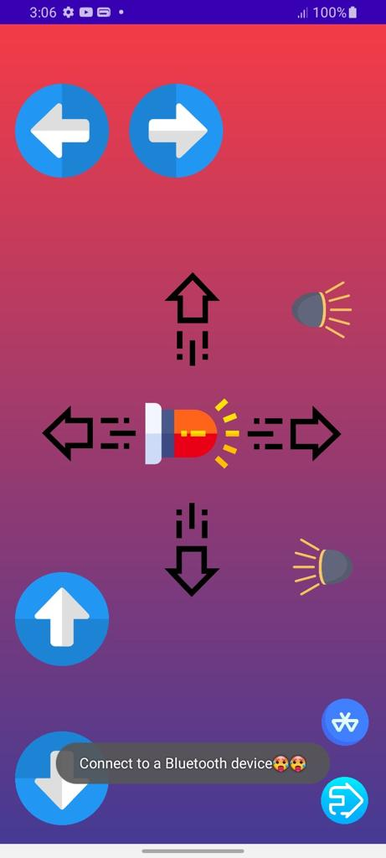
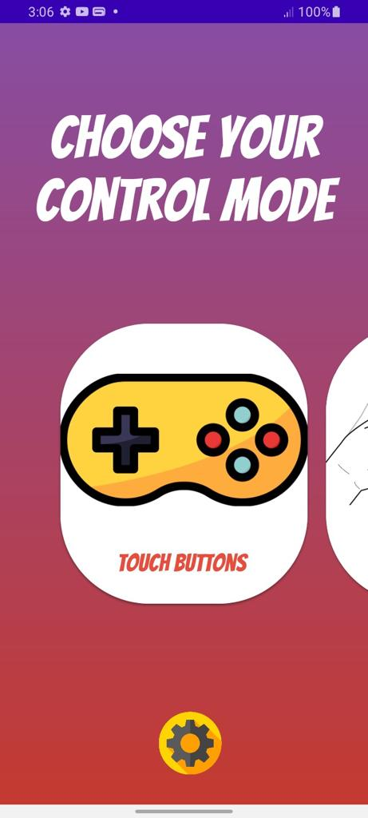
Screenshots from the android application

Slide 13
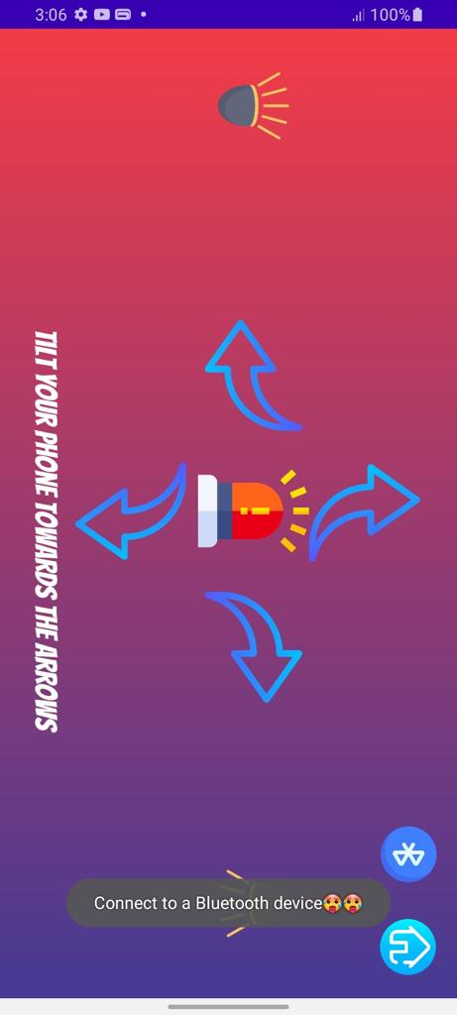
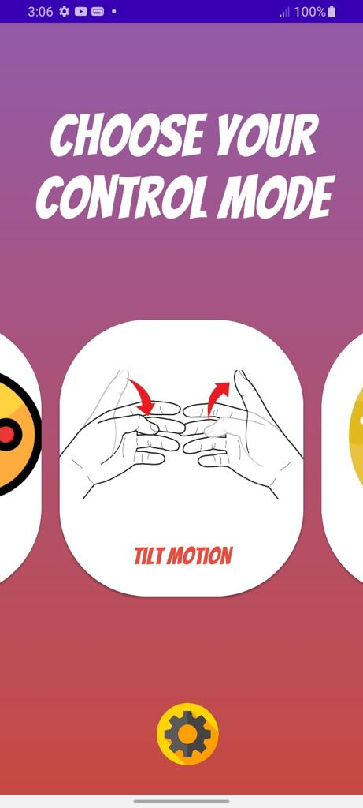
Screenshots from the android application

Slide 14
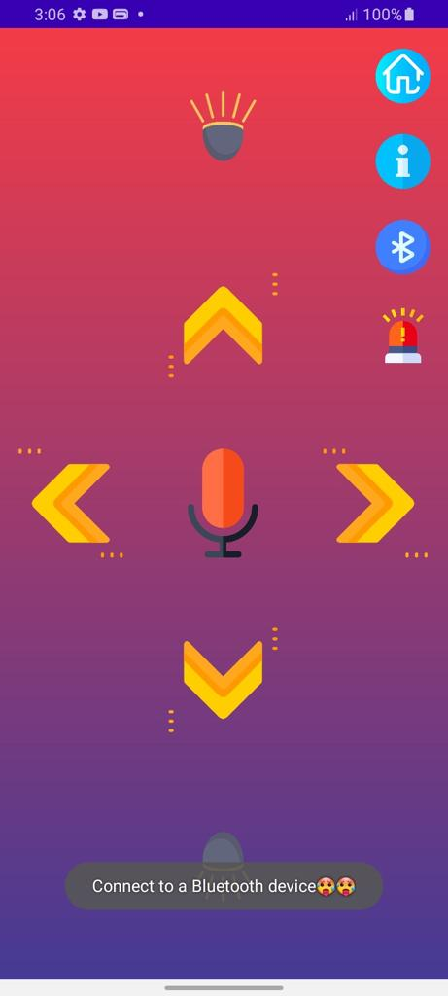
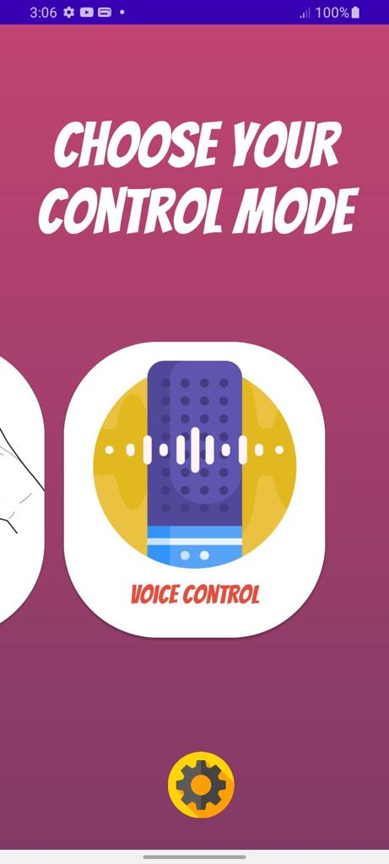
Screenshots from the android application

Slide 15
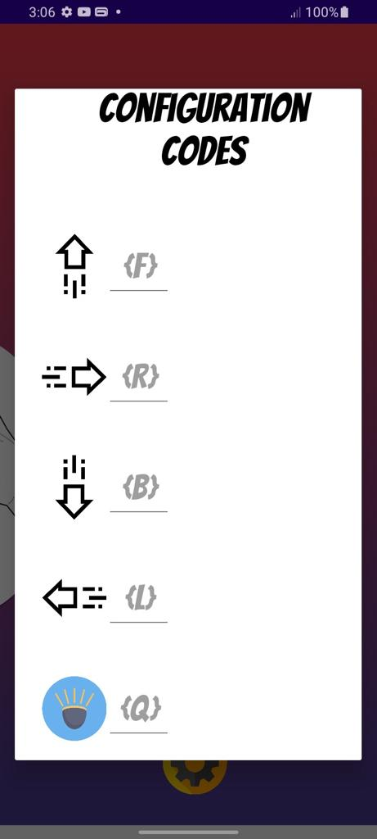
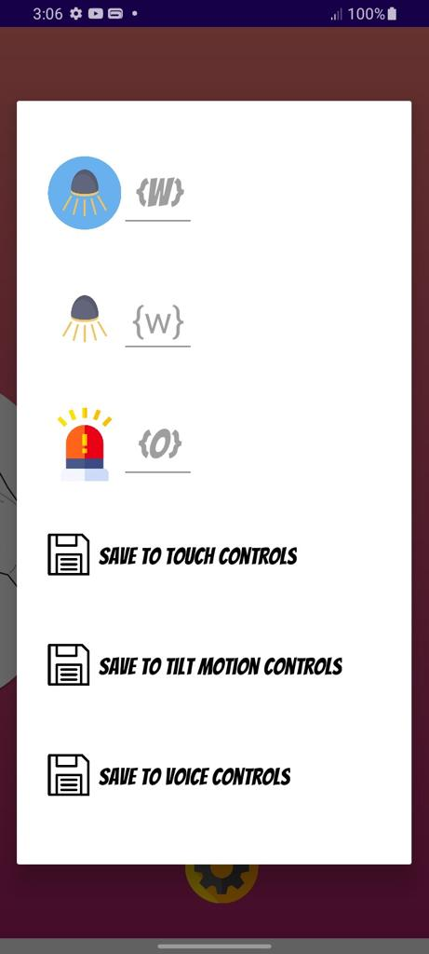
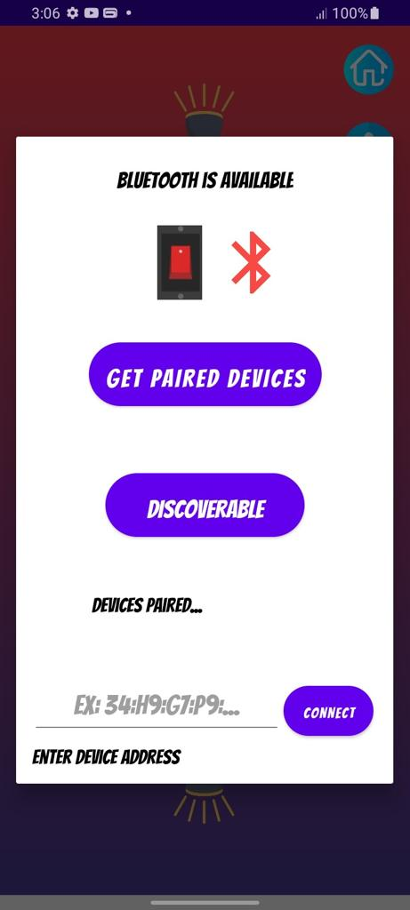
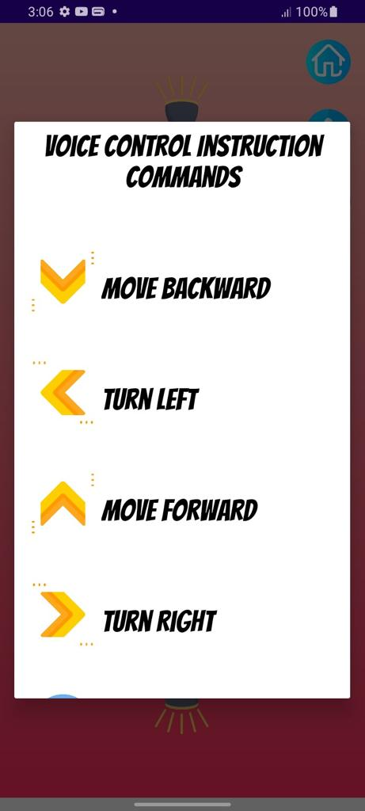
Screenshots from the android application

Slide 16
conclusion
The above model describes how the arduino programs the car motor module and by wireless connection we actually rotate the wheels and give direction to the car.

Slide 17
Source Codes
Github Source code for the android application:
https://github.com/Medhat-Ahmed-15/Bluetooth-Car-Controller-Android-App
Github Source code for the arduino program:
https://github.com/Medhat-Ahmed-15/Bluetooth-car-controller-arduino-program

Slide 18
References
1)Wang, F.Q. (2012) Research New Type of Supply Chain Management Model Based on theTechnology of Internet of Things—With Radio Frequency Identification (RFID) Technology as an Example.
2) Shen, S.B., Fang, Q.L. and Zong, P. (2009) Research of Internet of Things and related technology. Journal of Nanjing University of Posts and Telecommunications (Natural Science), 6, 1-11.
3) Wang, B.Y. (2009) Summary of IOT Technology Research. Journal of Electronic Measurement and Instrument, 12, 1-7.
4) Lin, G. (2012) Research on Complex Event of Supply Chain Decision Support Based on Internet of Things.
5) Han, Y. and Chai, Y.T. (2011) The Architecture Reference of Flexible Supply Chain Simulation System. Journal of System Simulation, 6, 1270-1278.

Slide 19


